Slide 1
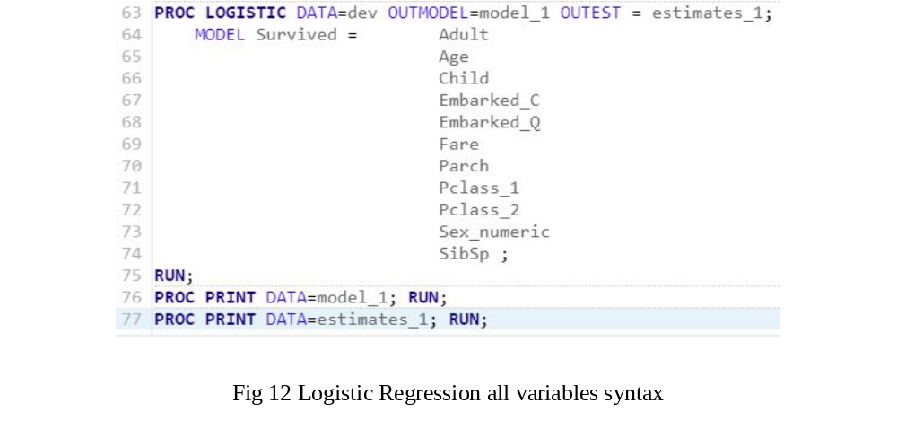
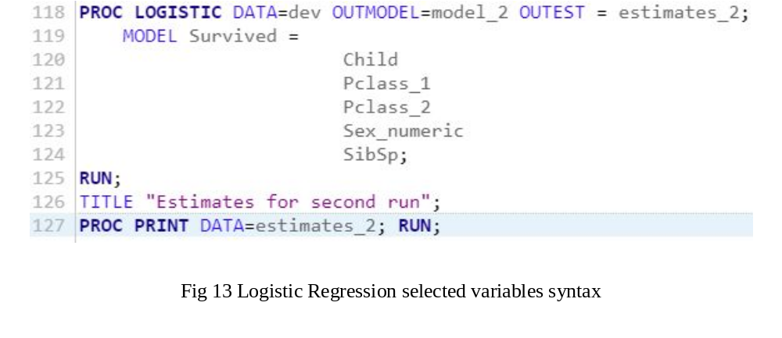
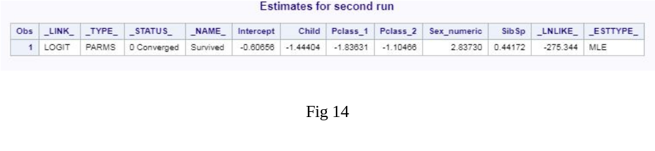
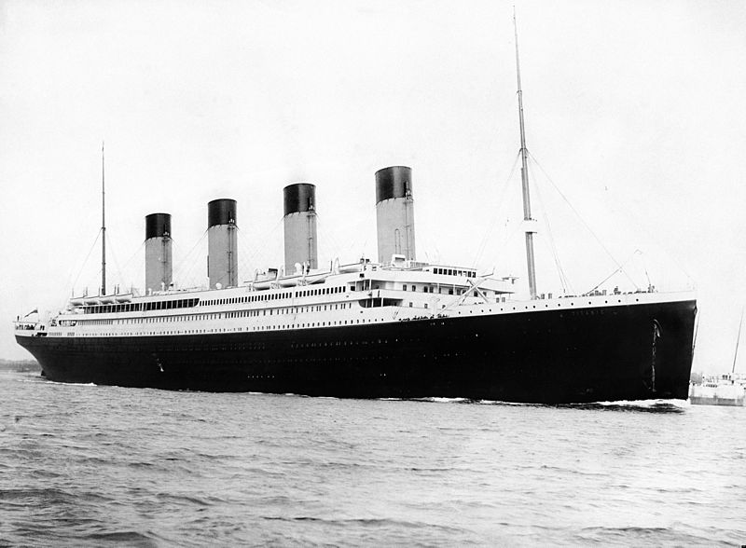
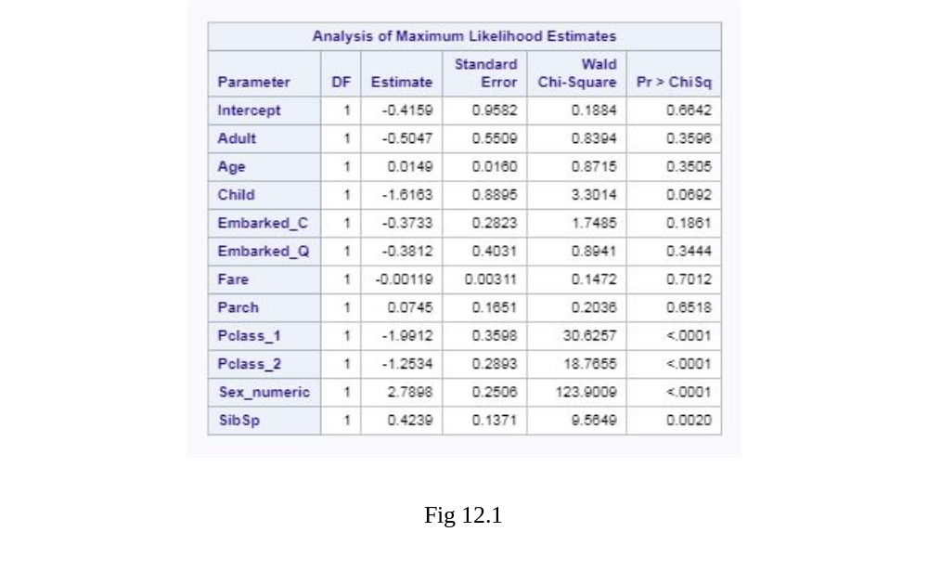
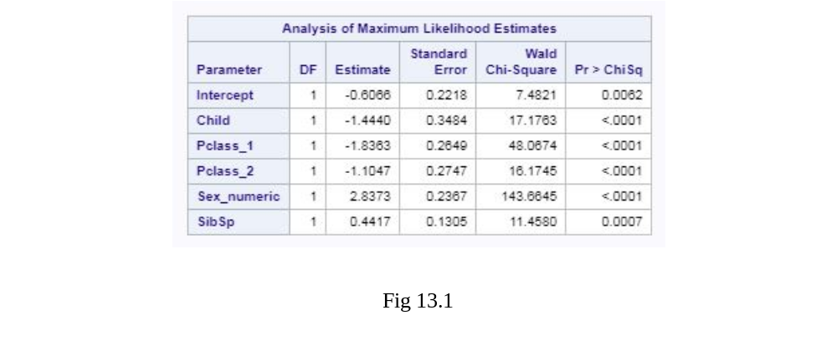
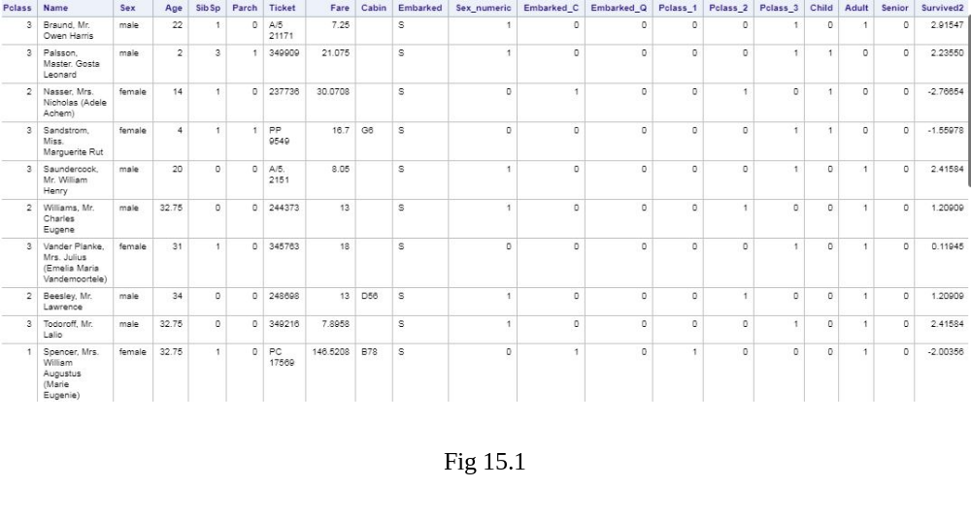
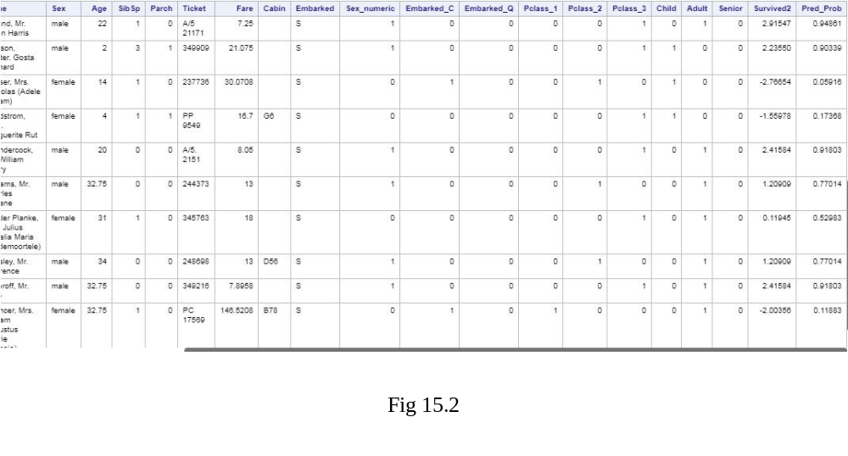
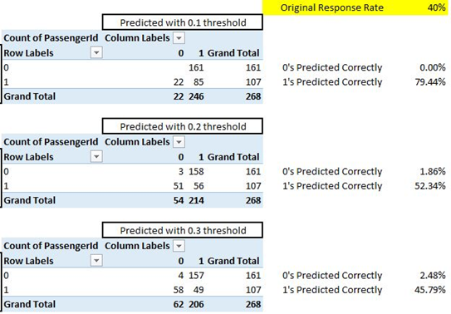
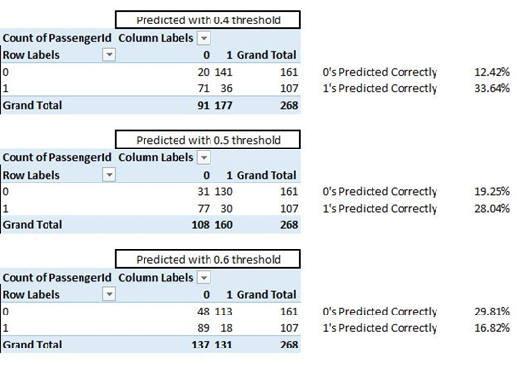
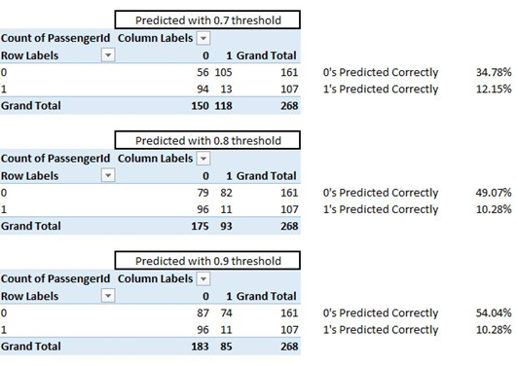


Joshua Troup
Clarion University
Introduction
Big data can be classified as a large set of complex data that is either structured, semi-structured, or non-structured that is not easily processed by the human eye or traditional applications. There are four main types’ of big data analytics methods that are used most frequently in businesses today. Prescriptive analytics determines what actions should be taken and is lead to be one of the most valuable type of analysis involving rules and recommendations. Diagnostic analytics uses past performance to determine what happened and why usually in a dashboard format. Descriptive analytics uses real time incoming data and data mining is typically performed. Predictive analytics uses likely scenarios of what might happen and delivered as a predictive forecast.
Results
The development of models will be an experimentation stage of the analysis. Multiple models will be developed experimenting with a variety of variables to determine the best fitting model to validate and test in later stages that will deliver the great amount of accuracy in predictive analytics.
Conclusions
The logistic models discovered sets of variables bearing statistically significant impacts on the likelihood of outcome of passengers on the Titanic shipwreck. The first model was developed with all variables to pinpoint significance in variable selection. The relative importance of predictors were decided by comparing the Test Chi-Square DF Pr > ChiSq value below a Threshold of 0.05. Model two includes all significant predictor variables with Test Chi-Square DF Pr > ChiSq below 0.05. Fig 16.1 displays the correlation matrix for all 268 observations with an original response rate of 40%. 0.1 Threshold indicates a strong correlation with (1) survived at a 79.44% and 0% of (0) non-survival. 0.2 Threshold indicates a fairly strong correlation with (1) survived at a 52.34% and a 1.86% of (0) non survival. 0.3 Threshold indicates a mildly strong correlation with (1) survived at a 45.79% and a 2.48% of (0) non survival. The pattern as the threshold increases continues to decrease in correlation (1) survived and increase (0) non survival. The five variables chosen with the smaller the threshold seem to be a good indicator of which passengers survived. Passenger Class (Pclass_1 & Pclass_2), Child, and Sex (Sex_numeric) are all strong correlating variables that indicate a strong case for survival. The saying “Women and children first” does seem to hold true based on the insights discovered in the data set. Siblings and Spouses (SibSp) variable is significant as well with many siblings (particularly female) and spouses being overly crowded in life boats. I predict not all siblings were female as the data does not portray the cowards fleeing to lifeboats with the women and children.
Coefficient and Intercept estimate equation as the following:
log(p/(1-p)) = -0.60656 + (-1.44404*Child) + (-1.83631*Pclass_1) + (-1.10466*Pclass_2)+(2.83730*Sex_numeric)+(0.44172*SibSp)
Materials and methods
SAS predictive analytics allow the user to modify the data with ease by structuring the data set, transpose them, and aggregate values into representative modeling tables. The Royal Mail Ship (RMS) Titanic goes down in history as one of the most infamous shipwrecks which sank after hitting an iceberg to the bottom of the ocean on April 15, 1912. 1,502 people were killed out of the 2,224 passengers and crewmen. One of the biggest reasons led to believe was the insufficient amount of the lifeboats to support all 2,224 passengers was one of the largest factors with women, children, and upper-class passengers more likely to board first increasing survival rate. My goal is to analyze the given data set about the passengers and develop my own predictions whether a passenger survived or not by using a 0 for no or 1 for yes value for the survived variable. Can I predict passenger survival using a supervised machine learning technique? To meet my goal, I will be using Logistic Regression algorithm.
Fig 12 and 12.1 show model one using logistic regression and all variables indicated in variable glossary. Using a 0.05 threshold, only Pclass_1, Pclass_2, Sex_numeric, and SipSp are relevant and less than threshold according to Pr > ChiSq in model 1. Model two includes the variable Child since it shows to be slightly above the 0.05 threshold.
Model two shown in Fig 13 and 13.1 displays the five significant variables from model one all well below the threshold of 0.05.
Fig 15.1-15.2 are the log odds in test score from model two. We now have the survival probability (Pred_Prob) variable calculated to see how well our model predicts passengers who survived or the ones who did not.
Fig 16.1 Correlation Matrix
Acknowledgments
I would like to thank Dr. Annadatha for his full support and effort throughout the entire course. The videos, PowerPoints, literature, articles, and assigned reading all have correlated into a well-developed program.
Further information
© Copyright Joshua Troup
Email: J.l.troup1@eagle.clarion.edu

